Slide 1
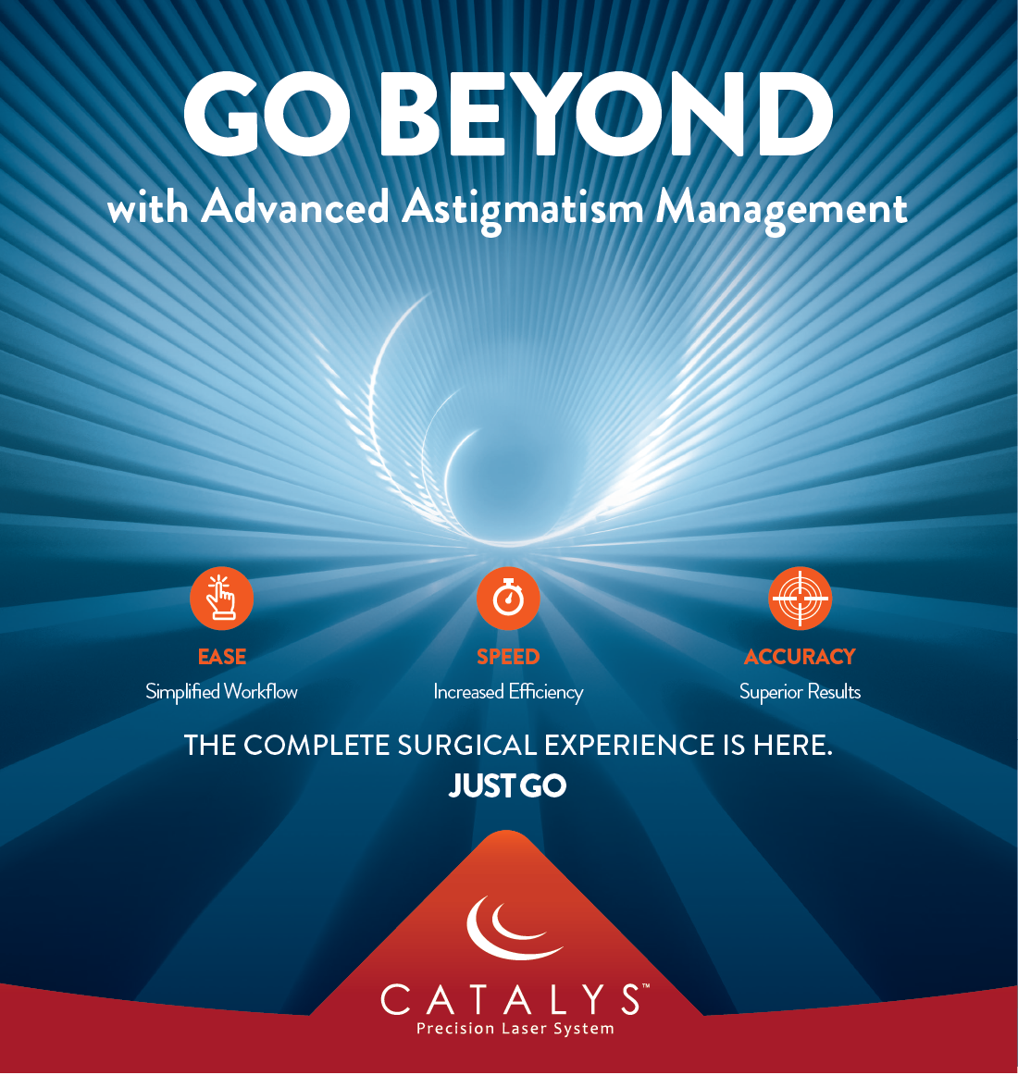

Slide 2
Overview
Prevalence of astigmatism in patients with cataracts 5
Astigmatism correction: well-being and cost savings 6
Percentage of clinically significant astigmatism correction 8
Patients with mild astigmatism benefit from correction 9
Limitations of available diagnostic and surgical methods 10

Slide 3
Overview (2)
CATALYSTM cOS 6.0: Improved arcuate incision workflow 12
CATALYSTM cOS 6.0: Improved toric IOL alignment workflow 13
Economic benefits for surgical centers 14
Economic benefits for surgeons 16
Benefits for patients, surgeons, and surgical centers 18

Slide 4
Astigmatism reduces distance and near visual acuity, vision quality, and depth perception^{1,2}

Slide 5
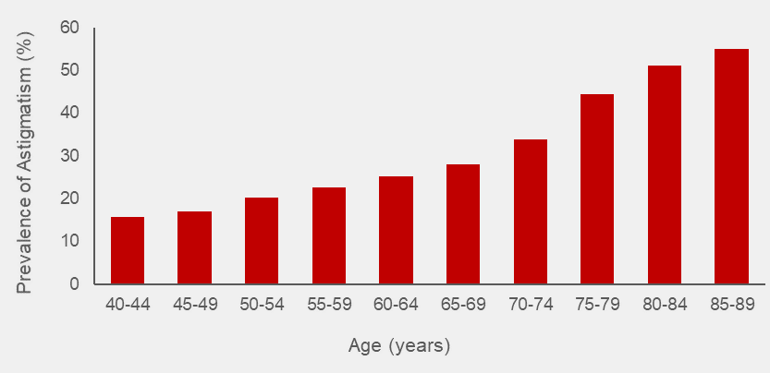
Moderate to severe astigmatism is prevalent in patients with cataracts
Prevalence of astigmatism increases with age*⁵
Globally, astigmatism ≥1.0 D affects 23% – 47% of patients with cataracts³
In the US, 38% of patients with cataracts have astigmatism ≥1.0 D⁴
6.5% of these cataracts patients have severe astigmatism of 2.0-3.0 D⁴
* Astigmatism defined as ≥1.0 D in a European population

Slide 6
Correction of astigmatism may improve patient well-being and provide cost savings as a result of reduced need for spectacles
Older patients correcting
distance and near vision with multifocal spectacles are 2X as likely to fall compared to those wearing single-vision spectacles⁶
The financial burden of a patient's fall is $2,044 to $25,955 US dollars⁸
Patients with post-cataract astigmatism paid ~2X more for spectacles than patients without astigmatism⁷

Slide 7
Correction of astigmatism during cataract surgery may reduce the need for glasses or contact lenses²
Note: Readers may still be necessary for patients with monofocal IOLs

Slide 8
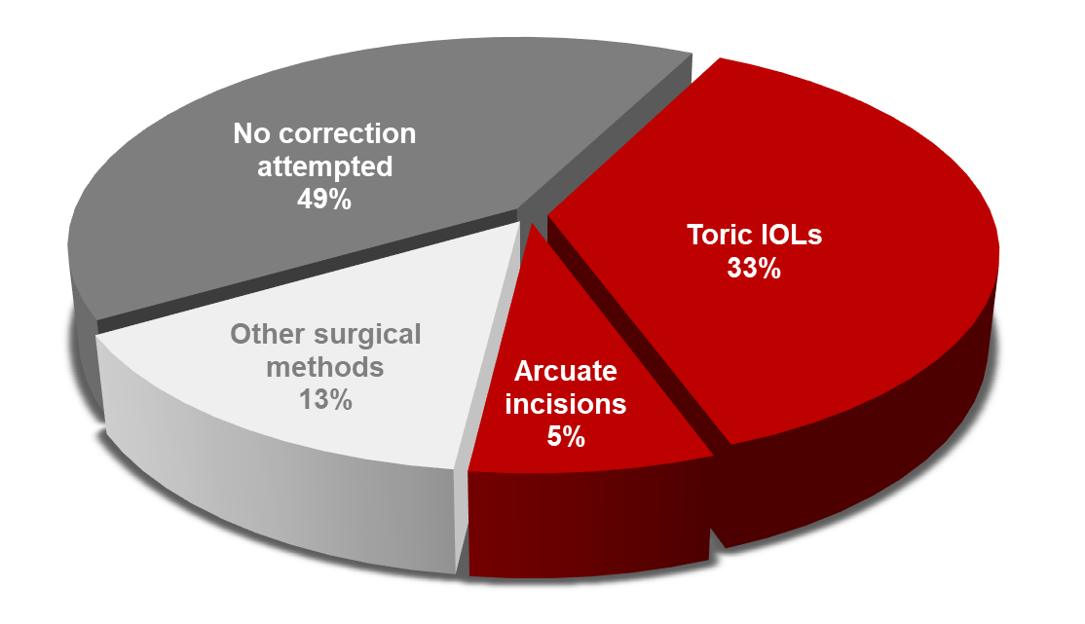
Despite the benefits, clinically significant astigmatism is not surgically corrected in many patients at the time of cataract surgery⁹
Surgical methods of astigmatism correction, including manual and automated techniques of varying cost and effectiveness, are underutilized (only 51%)⁹
95% of surgeons agree that clinically significant astigmatism should be corrected¹⁰
49% of surgeons do not attempt to correct significant levels of astigmatism (≥1.0 D) at the time of cataract surgery⁹
Source: Market Scope Q1-219 Survey of US Cataract Surgeons

Slide 9
Correction of mild astigmatism may benefit additional patients.
Despite the benefits, many patients are not corrected at the
time of cataract surgery.¹²
Mild astigmatism (0.25-1.0 D) is present in 51% of patients with cataracts⁴
Correction of astigmatism ≤0.75 D improves reading performance¹¹
Mild astigmatism is often uncorrected¹²

Slide 10
Limitations of the currently available diagnostic and surgical methods are some of the key barriers to surgical correction of astigmatism¹⁰
Toric IOL alignment methods present challenges for surgeons
Manual ink marking
Not reliable^{13,14}
Limited precision^{13,14}
Can cause patient discomfort¹⁵
Surgeon-dependent¹⁵
Automated intraoperative aberrometry
Limited efficacy^{16,17}
High cost¹⁸
Requires additional training¹⁹
Increases procedure time^{15,18,19}
There is a growing need for solutions that improve workflow and surgeon confidence

Slide 11
There is room for improvement in workflow for the surgical planning of astigmatism correction
CATALYSTM cOS 6.0 empowers surgeons
to optimize workflow for astigmatism management
EASE
SPEED
ACCURACY*
* Radial laser marks placed within a mean accuracy of 0.6° provide 5.5X greater precision compared to manual marking of the cornea with an ink pen (mean accuracy 3.3°)¹³

Slide 12
CATALYSTM cOS 6.0 improves arcuate incision workflow by reducing the number of process steps**
Pre-surgery
Surgery day
5
Total steps
Without cOS 6.0
Preoperative diagnostics
Online nomogram
Treatment planning
Ink mark
CATALYSTM procedure
Extra time estimated
per case
Up to 15 min Surgeon
Up to 7 min Technician
Up to 5 min Surgeon
Preoperative diagnostics
Up to 27 minutes saved
3
Total steps
With cOS 6.0
Preoperative diagnostics
Treatment planning
CATALYSTM procedure
total estimated time savings per case with CATALYSTM cOS 6.0*
*Time estimates by cataract surgeons based on iris registration procedure conducted with Cassini device in conjunction with CATALYS™ System use. Reflects the maximum time savings estimated by KOLs (n = 9 surgeons).²³
CATALYSTM cOS 6.0 can save time and reduce the risk of transcription errors**
** Workflow improvement compared to manual marking of the eye and manual calculation, transcription, and entry of data into the treatment plan. Import of preoperative diagnostic data eliminates manual transcription errors between devices.¹⁴

Slide 13
CATALYSTM cOS 6.0 improves toric IOL alignment workflow by reducing the number of process steps**
Pre-surgery
Surgery day
6
Total steps
Without cOS 6.0
Preoperative diagnostics
Treatment planning
Ink mark
CATALYSTM procedure
Ink mark
Toric IOL alignment/ intraoperative aberrometry
Extra time estimated
per case
Up to 7 min Technician
Up to 5 min Surgeon
Up to 3 min Surgeon
Up to 3 min Surgeon
4
Total steps
Up to 18 minutes saved
With cOS 6.0
Preoperative diagnostics
Treatment planning
CATALYSTM procedure
Toric IOL alignment
total estimated time savings per case using
CATALYSTM cOS 6.0*
---Within the OR. *Time estimates by cataract surgeons based on iris registration procedure conducted with Cassini device in conjunction with CATALYS™ System use. Reflects the maximum time savings estimated by KOLs (n = 9 surgeons)²³.
CATALYSTM cOS 6.0 improves throughput efficiency and incision accuracy**
** Workflow improvement compared to manual marking of the eye and manual calculation, transcription, and entry of data into the treatment plan. Import of preoperative diagnostic data eliminates manual transcription errors between devices.¹⁴

Slide 14
Improved workflow with CATALYSTM cOS 6.0 increases operational efficiency and may lead to economic value for surgical centers
Potential annual time savings per laser room
Potential increase in laser room capacity
Potential annual time savings per OR
Potential increase in OR capacity
Arcuate incisions
Surgeon: Up to 34 hours
Technician: Up to 47 hours
Up to 202 cases*
0 hours
0 cases
Toric IOLs
0 hours
0 cases
Up to 63 hours*
Up to 157 cases*
* Assumes an average duration of cataract surgery is 24 minutes and the OR is open for 8 hours a day for 50 weeks in a year.²⁰ Assumes average time in the laser room of 10 minutes.²⁰ Assumes 38% of patients with cataracts have astigmatism, with 33% being corrected with toric IOLs.^{4,9} Assumes 11% of cataract surgeries are with LCS and 73.3% of LCS procedure are arcuate incisions.^{9,21} The time savings estimates are based on the higher potential time savings presented on the previous slides (within the OR on the surgery day only).
Increased operational efficiency can lead to additional value for surgical centers and patients

Slide 15
Improved workflow with CATALYSTM cOS 6.0 increases operational efficiency and may lead to economic value for surgical centers
Potential annual savings per OR: 63 hours*
Could increase OR capacity by up to 157 cases*
Improved procedural efficiency has the potential to serve additional patients or reduce associated costs
=
* Assumes an average duration of cataract surgery is 24 minutes and the OR is open for 8 hours a day for 50 weeks in a year.²⁰ Assumes 38% of patients with cataracts have astigmatism, with 33% being corrected with toric IOLs.^{4,9} Assumes 11% of cataract surgeries are with LCS and 73.3% of LCS procedure are arcuate incisions.^{9,21} The time savings estimates are based on the higher potential time savings presented on the previous slides (within the OR on the surgery day only).
Increased operational efficiency can lead to additional value for surgical centers and patients

Slide 16
Improved workflow with CATALYSTM cOS 6.0 increases operational efficiency and may lead to economic value for surgeons
Potential annual time savings by the surgeon
Number of additional patients served annually
Pre-surgery day
Arcuate incisions
Up to 53 hours*
Up to 529 additional patients* outside the OR
Toric IOLs
0 hours*
0 patients*
Surgery day
Arcuate incisions
Up to 18 hours*
Up to 44 additional surgeries*
Toric IOLs
Up to 60 hours*
Up to 151 additional surgeries*
* The time savings estimates are based on the higher potential time on the pre-surgery and surgery days. Assumes that a surgeon works for 48 weeks per year, 5 days per week (with 50% of the time in office and 50% in the OR), that 10 patients are seen during office visits per hour. Assumes 38% of patients with cataracts have astigmatism, with 33% being corrected with toric IOLs. Assumes 11% of cataract surgeries are with LCS and 73.3 % of LCS procedure are arcuate incisions.^{9,21} Assumes an average duration of surgery of 24 minutes.²⁰
Time savings with CATALYSTM cOS 6.0 can allow surgeons to serve additional patients

Slide 17
Improved workflow with CATALYSTM cOS 6.0 increases operational efficiency and may lead to economic value for surgeons
A surgeon may save up to 53 hours annually on pre-surgery days*
Up to 529 additional patients annually*
=
CATALYSTM cOS 6.0 may allow time for additional procedures
A surgeon may save up to 78 hours annually on surgery days*
Up to 195 additional surgeries annually*
* The time savings estimates are based on the higher potential time on the pre-surgery and surgery days. Assumes that a surgeon works for 48 weeks per year, 5 days per week (with 50% of the time in office and 50% in the OR), that 10 patients are seen during office visits per hour. Assumes 38% of patients with cataracts have astigmatism, with 33% being corrected with toric IOLs. Assumes 11% of cataract surgeries are with LCS and 73.3 % of LCS procedure are arcuate incisions.^{9,21} Assumes an average duration of surgery of 24 minutes.²⁰
Time savings with CATALYSTM cOS 6.0 can allow surgeons to serve additional patients

Slide 18
CATALYSTM cOS 6.0 facilitates astigmatism management and may provide benefits for patients, surgeons, and surgical centers²³
Potential Patient Benefits
More options for astigmatism planning²²
Reduced procedure time*
Customized treatment planning²²
Potential Surgeon Benefits
Integration of data and laser-aided marks for toric IOL alignment²²
Additional time available without increased clinic or surgery schedule*
Customized surgeon preferences²²
Potential Surgical Center Benefits
Opportunity to serve more patients*
Increased surgical capacity without a need to set up an additional OR*
* Based on the time savings presented on the previous slides.

Slide 19
References
Wolffsohn JS, Bhogal G, Shah S (2011) Effect of uncorrected astigmatism on vision. J Cataract Refract Surg 37 (3): 454-460.
Read SA, Vincent SJ, Collins MJ (2014) The visual and functional impacts of astigmatism and its clinical management. Ophthalmic Physiol Opt 34 (3): 267-294.
Anderson DF, Dhariwal M, Bouchet C, Keith MS (2018) Global prevalence and economic and humanistic burden of astigmatism in cataract patients: a systematic literature review. Clin Ophthalmol 12 439-452.
Hill WE (2019) Prevalence of corneal astigmatism prior to cataract surgery. Available at: https://www.doctor-hill.com/iol-main/astigmatism_chart.htm; Accessed December 17, 2019.
Williams KM, Verhoeven VJ, Cumberland P, Bertelsen G, Wolfram C et al. (2015) Prevalence of refractive error in Europe: the European Eye Epidemiology (E(3)) Consortium. Eur J Epidemiol 30 (4): 305-315.
Lord SR, Dayhew J, Howland A (2002) Multifocal glasses impair edge-contrast sensitivity and depth perception and increase the risk of falls in older people. J Am Geriatr Soc 50 (11): 1760-1766.
Kim H, Lim S, Cho B, et al (2010) Astigmatism and cost of post-cataract surgery spectacle wear in Korea. Value Health 13 (7): A563.
Peel NM (2011) Epidemiology of falls in older age. Can J Aging 30 (1): 7-19.
Market Scope (2019) 2019 Annual sponsored US cataract surgeon survey report.
ASCRS (2018) Sixth annual ASCRS clinical survey. Available at: http://supplements.eyeworld.org/eyeworld-supplements/december-2018-clinical-survey; Accessed November 29, 2019.
Lehmann RP, Houtman DM (2012) Visual performance in cataract patients with low levels of postoperative astigmatism: full correction versus spherical equivalent correction. Clin Ophthalmol 6 333-338.
Jones MP (2019) Neglect negligible astigmatism no more. Ophthalmology Management Available at: https://www.ophthalmologymanagement.com/issues/2019/may-2019/neglect-negligible-astigmatism-no-more; Accessed November 29, 2019
Visser N, Berendschot TT, Bauer NJ, Jurich J, Kersting O et al. (2011) Accuracy of toric intraocular lens implantation in cataract and refractive surgery. J Cataract Refract Surg 37 (8): 1394-1402.
Dick HB, Schultz T (2016) Laser-assisted marking for toric intraocular lens alignment. J Cataract Refract Surg 42 (1): 7-10.
Titiyal JS, Kaur M, Jose CP, Falera R, Kinkar A et al. (2018) Comparative evaluation of toric intraocular lens alignment and visual quality with image-guided surgery and conventional three-step manual marking. Clin Ophthalmol 12 747-753.
Huelle JO, Druchkiv V, Habib NE, Richard G, Katz T et al. (2017) Intraoperative aberrometry-based aphakia refraction in patients with cataract: status and options. Br J Ophthalmol 101 (2): 97-102.
Solomon KD, Sandoval HP, Potvin R (2019) Evaluating the relative value of intraoperative aberrometry versus current formulas for toric IOL sphere, cylinder, and orientation planning. J Cataract Refract Surg 45 (10): 1430-1435.
Roach L (2013) Intraoperative wavefront aberrometry: wave of the future? Available at: https://www.aao.org/eyenet/article/intraoperative-wavefront-aberrometry-wave-of-futur; Accessed: November 29, 2019.
Mahdavi S (2013) Impact of ORA on refractive cataract surgery and the premium channel offering. Available at: https://eyetube.net/series/wavetec-ora/pdfs/WaveTec%20ORA%20SM2%20Report4.11.13.pdf; Accessed November 29, 2019.
Roberts HW, Ni MZ, O'Brart DP (2017) Financial modelling of femtosecond laser-assisted cataract surgery within the National Health Service using a 'hub and spoke’ model for the delivery of high-volume cataract surgery. BMJ Open 7 (3): e013616
Market Scope (2019). 2019 Cataract surgical equipment market report.
Johnson & Johnson Vision. 2019. CATALYSTM Precision Laser System Software Release cOS 6 Verbal Communication Script. PP2019CT5046.
Johnson & Johnson Vision. 2019. CATALYS™ Value Brief KOL Evidence Feedback 02062020 (v0.1). REF2020CT4089.

Slide 20
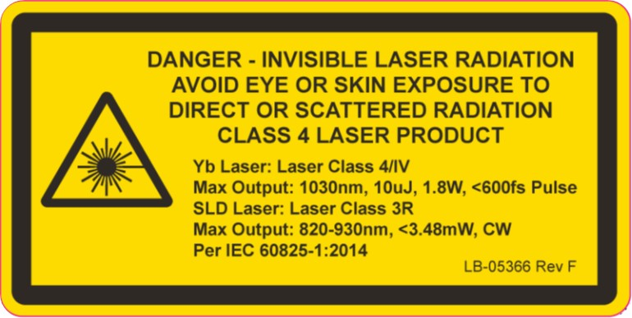
Indications and Important Safety Information
Rx Only.
INDICATIONS: The CATALYSTM Precision Laser System is indicated for use in patients undergoing cataract surgery for removal of the crystalline lens. Intended uses in cataract surgery include anterior capsulotomy, phacofragmentation, and the creation of single plane and multi-plane arc cuts/incisions in the cornea, each of which may be performed either individually or consecutively during the same procedure.
CONTRAINDICATIONS: The CATALYSTM Precision Laser System should not be used if patients are not candidates for cataract surgery, have certain pre-existing corneal problems or eye implants; or if patients are younger than 22 years of age. Patients should tell their doctor about any eye-related conditions, injuries, or surgeries.
CAUTION: The system should be used only by qualified physicians who have extensive knowledge of the use of this device and have been trained and certified.
ATTENTION: Reference the labelling for a complete listing of Indications and Important Safety Information.
PRECAUTIONS: Patients must be able to lie flat on their backs and motionless during the procedure. Patients must be able to tolerate local or topical anesthesia. Patients should tell their doctor if they are taking any medications such as alpha blockers (like Flomax® to treat an enlarged prostate) as these medications may affect how the doctor does the cataract surgery.
ADVERSE EFFECTS: Complications associated with the CATALYSTM System include mild broken blood vessels or redness on the white part of the eye, which may last for a few weeks. Other potential risks associated with cataract surgery may occur. These risks may include but are not limited to corneal swelling and/or abrasion, lens capsular tear, infection, inflammation, eye discomfort and reduced vision. Patients should talk to their doctor about all the potential risks associated with these procedures.
These are not actual patients and images are for illustrative purposes only.
® Johnson & Johnson Surgical Vision, Inc. 2020 │PP2020CT4019

