Slide 1
Sample Social Media Posts for Patient Education
This document provides proposed social copy and creative inspiration and assets for Facebook, Instagram and Twitter to educate patients about eye health and a safe return to eye care during the COVID-19 pandemic.
PP2020OTH5423

Slide 2
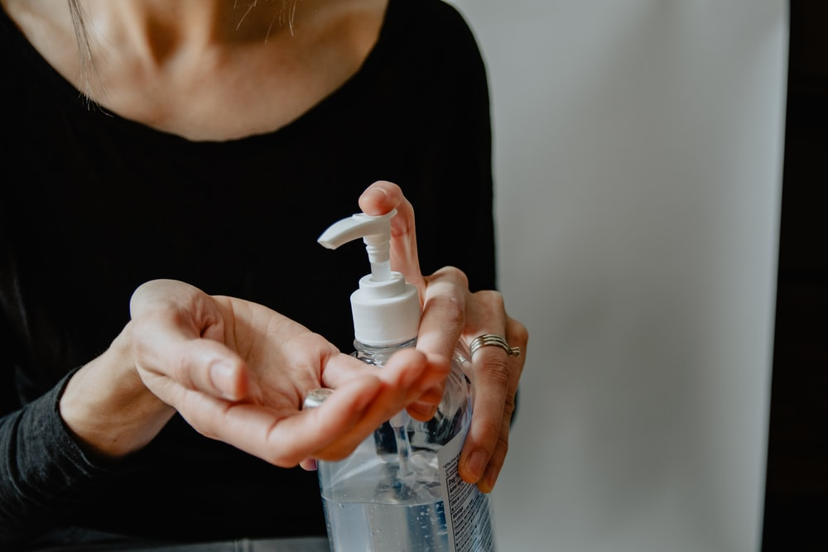
Reopening Safely
COPY
As we begin to reopen for care or procedures, your #eyehealth and safety are our top priority. Here are the actions we are taking to prevent infection:
[Insert actions taken]
IMAGE (Right click, choose “Save as Picture” to save locally)
Note: Recommend taking a photo demonstrating your clinic’s increased precautions
PP2020OTH5423
Notes:
Royalty free image source: https://unsplash.com/photos/3FHp2yOPDxU

Slide 3
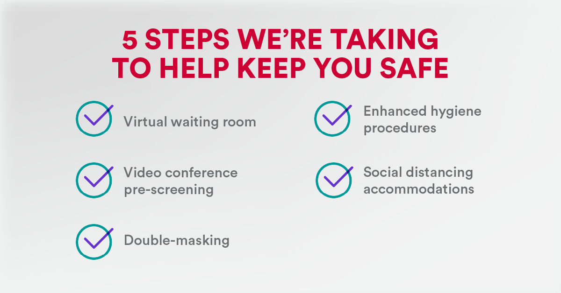
Reopening Safely
COPY
Things have changed around here! Here are 5 things we’re doing to help keep you safe. Contact our office to learn more:
[LINK: Your clinic’s website and/or phone number to explain virtual waiting room, etc.]
IMAGE (Right click, choose “Save as Picture” to save locally)
PP2020OTH5423

Slide 4
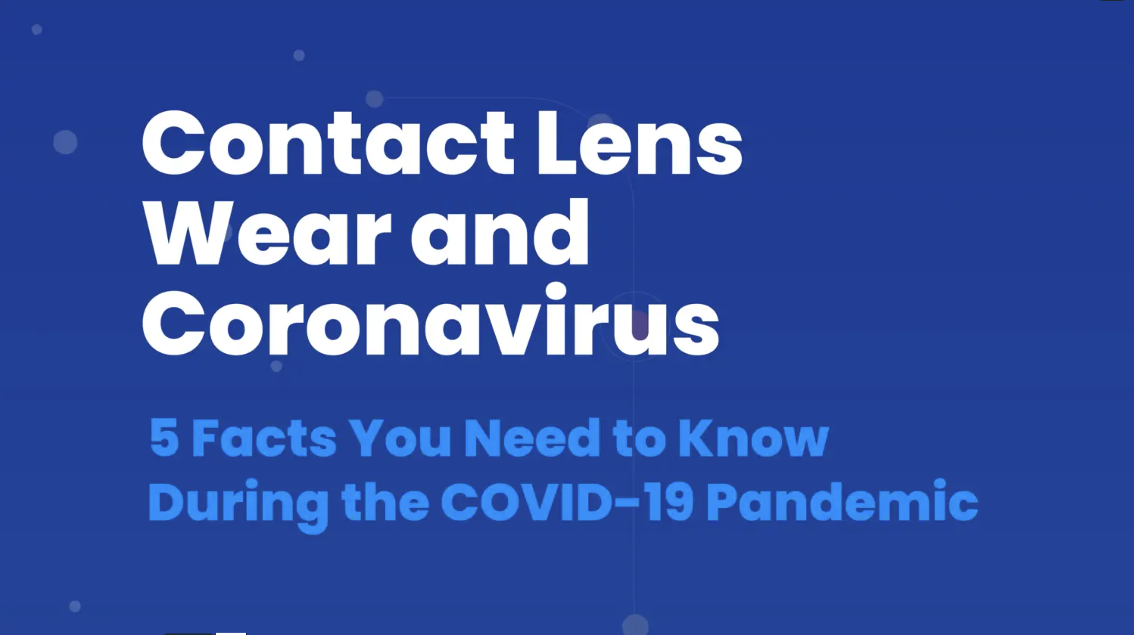
Eye Health: COVID-19
COPY
Worried about wearing contacts during COVID-19? A new peer-reviewed paper from five of the world’s most prominent ocular researchers reassures contact lens wearers that there is currently no scientific evidence that contact lens wearers have an increased risk of contracting #COVID19 compared to eyeglass wearers #eyecare
[LINK: COVIDEyeFacts.org]
IMAGE (Download the full infographic here [hyperlink to toolkit] to save locally)
PP2020OTH5423

Slide 5
Reopening Safely
COPY
Big thanks to this group at [Insert your clinic], who are working extra hard to help ensure our patients are safe and protected while caring for their #eyehealth.
[LINK: to your clinic’s website]
IMAGE (Download the full infographic here [hyperlink to toolkit] to save locally)
Sample photo; use photo of your staff
PP2020OTH5423

Slide 6
Eye Health: Increased Screen Time
COPY
Did you know increased screen time could be impacting your eye health? Check out this article on how to protect your eyes:
[LINK: https://www.aoa.org/news/clinical-eye-care/covid-19-digital-eyestrain]
IMAGE (Right click, choose “Save as Picture” to save locally)
PP2020OTH5423

Slide 7
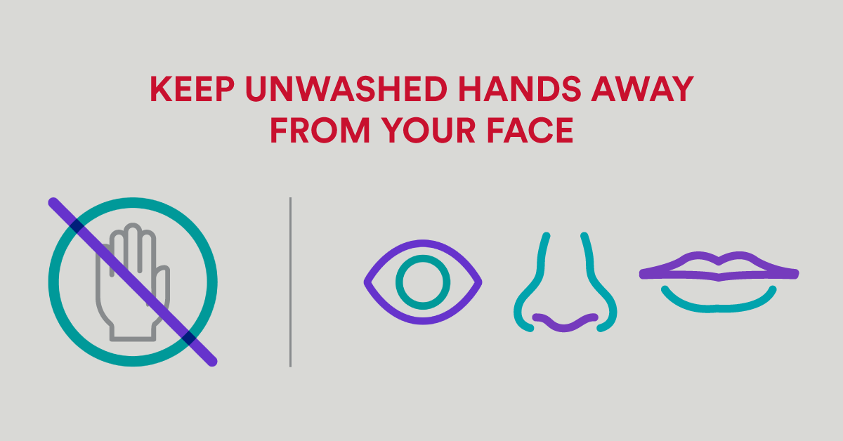
Eye Health COVID-19
COPY
Helpful tips on good eye hygiene during the COVID-19 pandemic.
[LINK: https://www.aoa.org/patients-and-public/caring-for-your-vision/contact-lenses/what-you-need-to-know-about-contact-lens-hygiene-and-compliance]
IMAGE (Right click, choose “Save as Picture” to save locally)
PP2020OTH5423

Slide 8
Eye Health: COVID-19
COPY
There is currently no scientific evidence that contact lens wearers have an increased risk of contracting #COVID19 compared to eyeglass wearers, according to a new peer-reviewed paper.
IMAGE (Download the full infographic here [hyperlink to toolkit] to save locally)
PP2020OTH5423

Slide 9
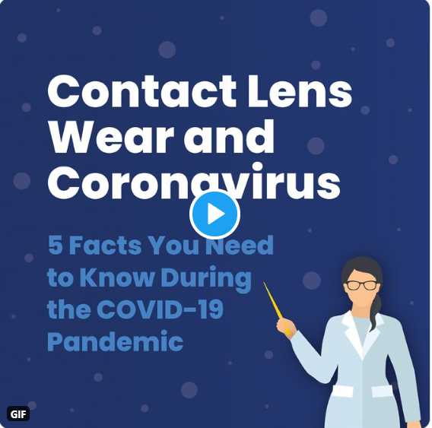
Eye Health: COVID-19
COPY
A new peer-reviewed paper led by @COREeyenews shows that contact lens wearers don’t have an increased risk of contracting #COVID19 compared to eyeglass wearers and recommends those with active infections wear spectacles.
[LINK: COVIDEyeFacts.org]
IMAGE (Download the full infographic here [hyperlink to toolkit] to save locally)
PP2020OTH5423

Slide 10
Eye Health: Increased Screen Time
COPY
Looking at screens more recently? Check out this article on how to help protect your eyes:
[LINK: https://www.aoa.org/news/clinical-eye-care/covid-19-digital-eyestrain]
IMAGE (Right click, choose “Save as Picture” to save locally)
PP2020OTH5423
Notes:
Royalty free image source: https://www.pexels.com/photo/photo-of-woman-leaning-on-table-3747405/

Slide 11
Eye Health COVID-19
COPY
Helpful tips on how good eye hygiene during the COVID-19 pandemic:
[LINK: https://www.aoa.org/patients-and-public/caring-for-your-vision/contact-lenses/what-you-need-to-know-about-contact-lens-hygiene-and-compliance]
IMAGE (Right click, choose “Save as Picture” to save locally)
PP2020OTH5423

Slide 12
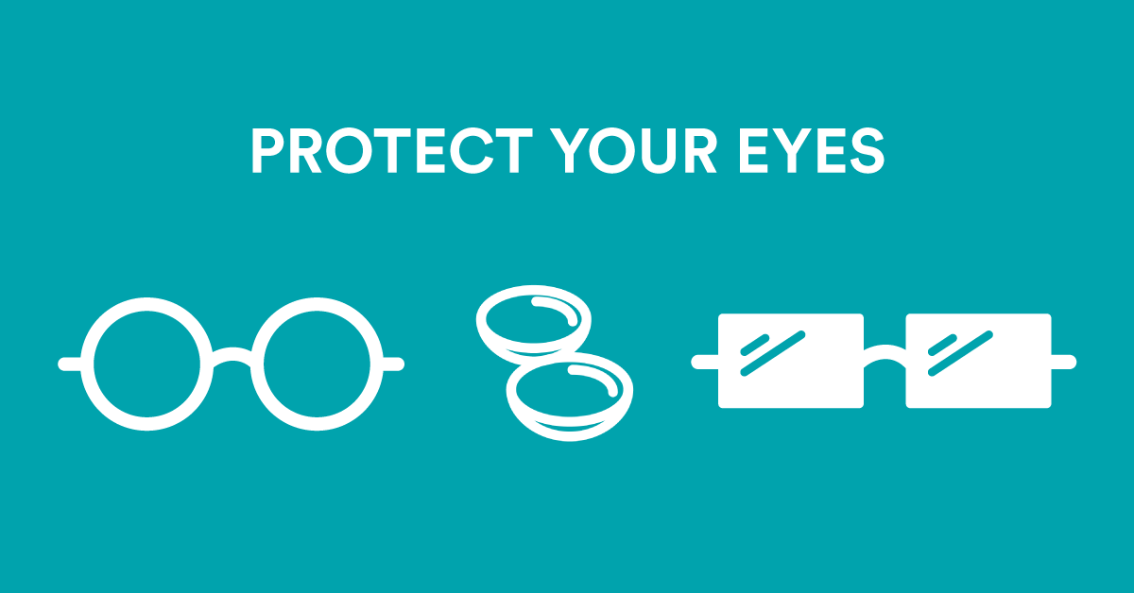
Eye Health COVID-19
COPY
As always, good hygiene habits are critical when wearing contact lenses. Wash and dry your hands before handling and ensure proper wear and care, including good contact lens case hygiene.
[Link to https://www.cdc.gov/contactlenses/protect-your-eyes.html]
IMAGE (Right click, choose “Save as Picture” to save locally)
PP2020OTH5423

Slide 13
Eye Health COVID-19
COPY
Contact lens wearers do NOT have an increased risk of contracting #COVID-19, compared to eyeglass wearers, according to a new peer-reviewed paper. Read here to learn how to stay safe.
[Link to COVIDEyeFacts.org]
IMAGE (Right click, choose “Save as Picture” to save locally)
PP2020OTH5423

Slide 14
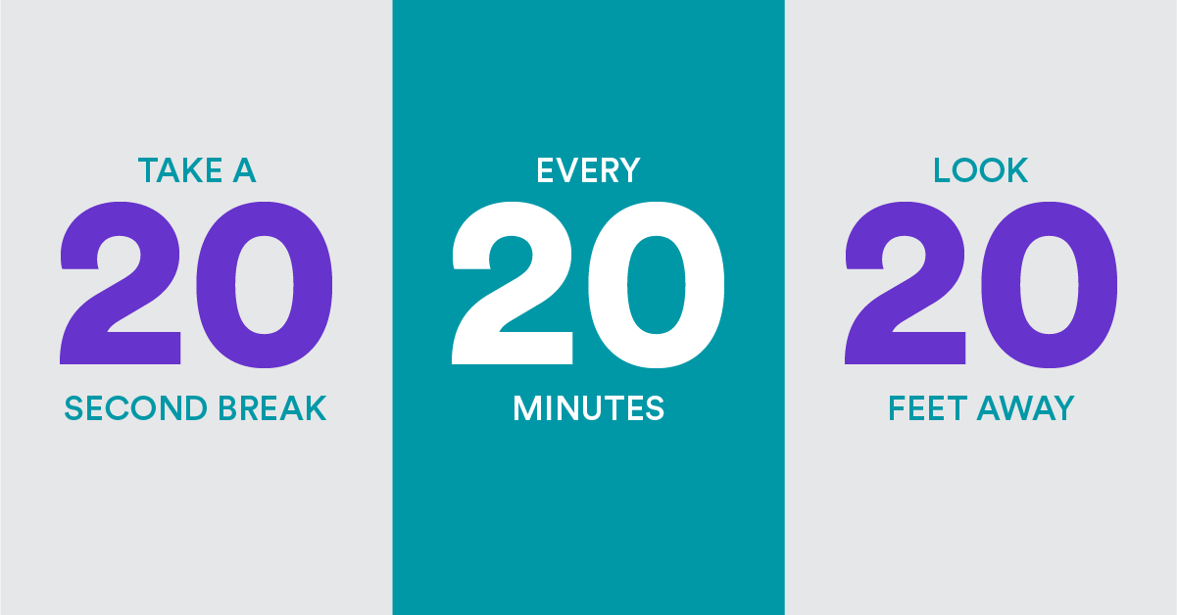
Eye Health COVID-19
COPY
Spending more time looking at screens? Try and follow the 20-20-20 rule: Take a 20-second break, every 20 minutes, look 20 feet away
[Link to https://www.aao.org/eye-health/tips-prevention/computer-usage]
IMAGE (Right click, choose “Save as Picture” to save locally)
PP2020OTH5423

Slide 15
Additional ideas for social content
Photos, graphics and videos drive higher engagement, and we recommend using photos of your team and clinic where relevant
Resources:
Images: Pexels.com and Unsplash.com that offer photos for royalty-free use
CORE: COVIDEyeFacts.org
CDC: Protect Your Eyes
American Academy of Ophthalmology
American Optometric Association (AOA)
PP2020OTH5423

